Slide 1
Java Files

Slide 2
Java File Handling
The File class from the java.io package, allows us to work with files.
To use the File class, create an object of the class, and specify the filename or directory name:
Example
import java.io.File; // Import the File class
File myObj = new File("filename.txt"); // Specify the filename

Slide 3
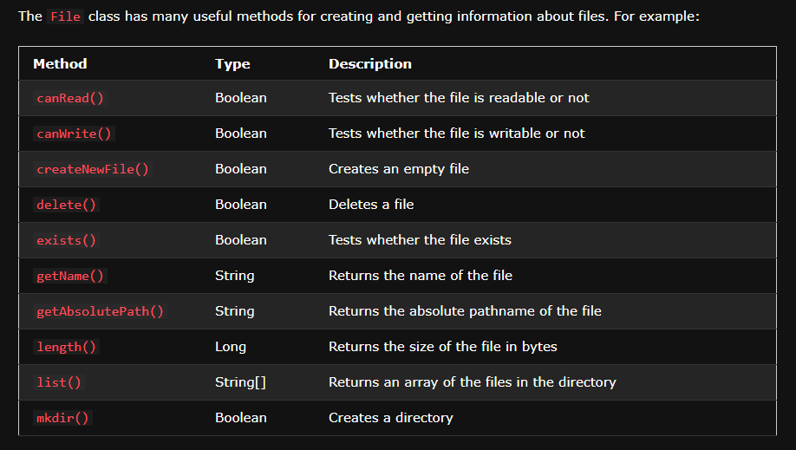

Slide 4
Java Create and Write To Files

Slide 5
Create a File
To create a file in Java, you can use the createNewFile() method. This method returns a boolean value: true if the file was successfully created, and false if the file already exists. Note that the method is enclosed in a try...catch block. This is necessary because it throws an IOException if an error occurs (if the file cannot be created for some reason):

Slide 6
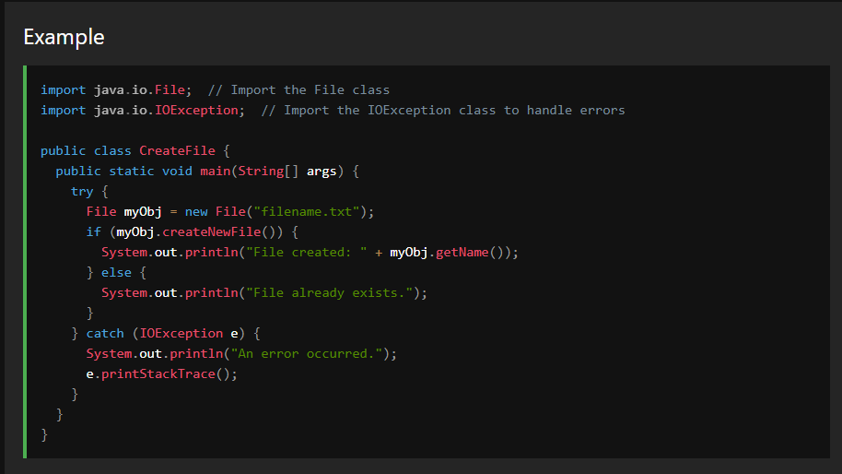

Slide 7
Write To a File
In the following example, we use the FileWriter class together with its write() method to write some text to the file we created in the example above. Note that when you are done writing to the file, you should close it with the close() method:

Slide 8
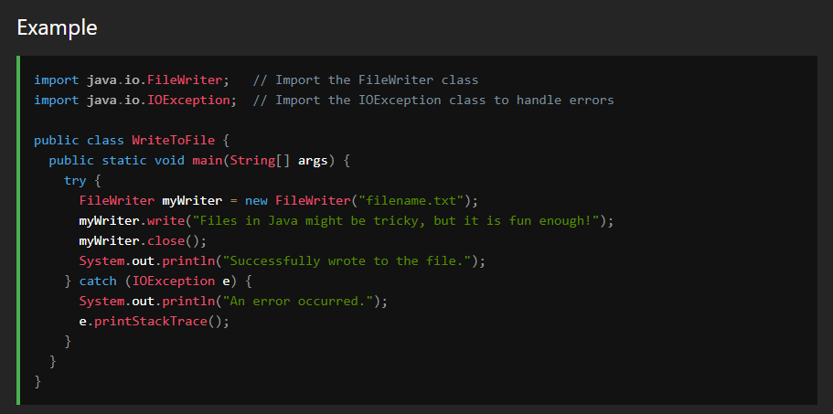

Slide 9
Java Read Files

Slide 10
Read a File
In the previous chapter, you learned how to create and write to a file.
In the following example, we use the Scanner class to read the contents of the text file we created in the previous chapter:

Slide 11
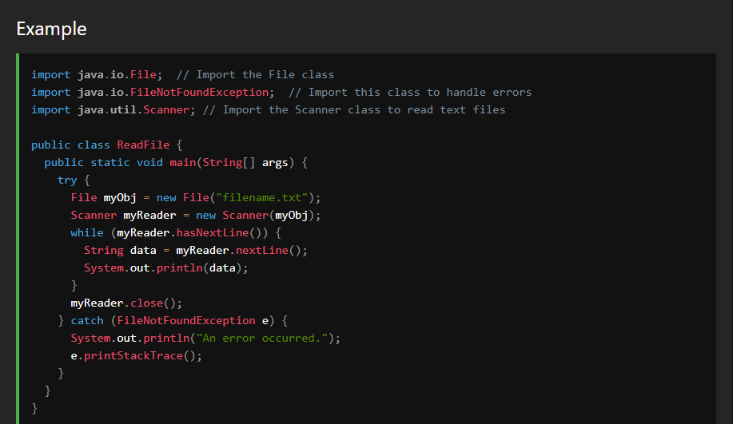

Slide 12
Note: There are many available classes in the Java API that can be used to read and write files in Java: FileReader, BufferedReader, Files, Scanner, FileInputStream, FileWriter, BufferedWriter, FileOutputStream, etc. Which one to use depends on the Java version you're working with and whether you need to read bytes or characters, and the size of the file/lines etc.

Slide 13
Java Delete Files

Slide 14
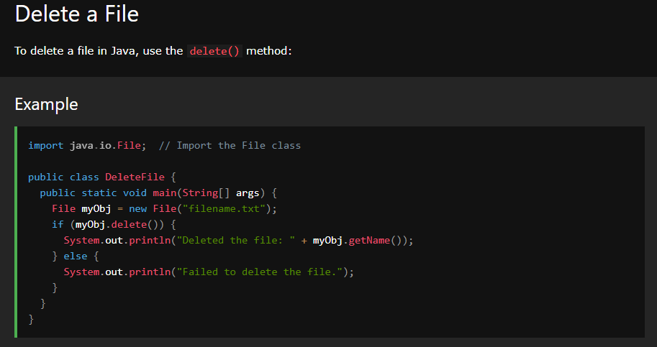

Slide 15
